Slide 1

Working with Assistants Part 3: Managing Assistants

Slide 2
Alexandra Erin
“Do not meddle in the affairs of Administrative Assistants, for they are petty and quick to misfile.”

Slide 3



Notes:
https://www.youtube.com/channel/UC35ZpwldGw7ZJ5R-2sLijzw

Slide 4

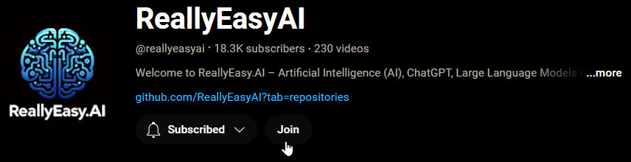
Membership has its privileges
Notes:
https://www.youtube.com/channel/UC35ZpwldGw7ZJ5R-2sLijzw/join

Slide 5
Creating Assistants Review
Let’s Make Some Assistants!
Notes:
https://platform.openai.com/docs/api-reference/assistants/createAssistant

Slide 6
Demo: Creating Assistants Review
from openai import OpenAI
# Create an instance of the OpenAI class.
client = OpenAI()
# Create an assistant that uses code interpreter.
assistant = client.beta.assistants.create(
model="gpt-4-turbo",
instructions="You are a personal data analyst. When asked a question, write and run Python code to answer the question.",
name="Code Interpreter Assistant",
metadata={
"key": "value",
"is_awesome": "True", # Lowercase dictionary keys
"is_beta": "False"
},
temperature=1,
top_p=1,
response_format="auto",
tools=[{"type": "code_interpreter"}],
tool_resources=None,
)

Slide 7
Listing Assistants
What Assistants Do I Have?
Notes:
https://platform.openai.com/docs/api-reference/assistants/listAssistants

Slide 8
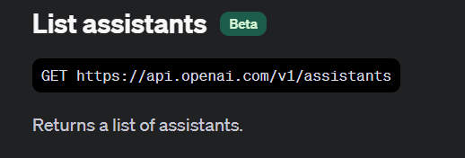

Slide 9
Demo: Simple List
from openai import OpenAI
client = OpenAI()
my_assistants = client.beta.assistants.list(
)
print("Number of Assistants: " + str(len(my_assistants.data)))
print("\n")
for assistant in my_assistants.data:
print(assistant.id)
print(assistant.name)
print("\n")

Slide 10
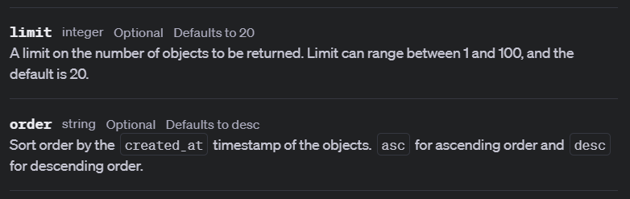

Slide 11
Demo: Limit and Order
from openai import OpenAI
client = OpenAI()
my_assistants = client.beta.assistants.list(
limit=5,
order="asc", )
print("Number of Assistants: " + str(len(my_assistants.data)))
print("\n")
for assistant in my_assistants.data:
print(assistant.id)
print(assistant.name)
print("\n")

Slide 12
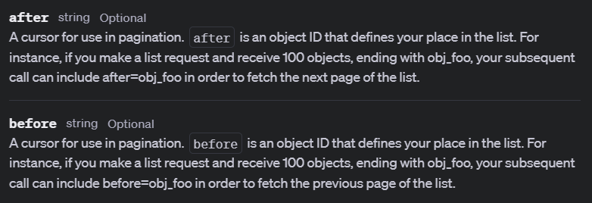

Slide 13
Demo: Pagination
from openai import OpenAI
client = OpenAI()
# Start with no initial 'after' ID
after_id = None
# Loop to fetch all pages of data until no more data is available going forward
while True:
my_assistants = client.beta.assistants.list(
limit=4,
order="asc",
after=after_id # Use the last received ID as the 'after' parameter
)
# Check if data received is empty, which means no more data to fetch
if not my_assistants.data:
break
# Process each assistant
for assistant in my_assistants.data:
print(assistant.id)
print(assistant.name)
print("\n")
# Update 'after_id' to the last assistant's ID in the current page
after_id = my_assistants.data[-1].id
# Put in a marker to show each page is done
print("===END OF PAGE===\n")

Slide 14
Modifying Assistants
The Only Constant in the Universe is Change!
Notes:
https://platform.openai.com/docs/api-reference/assistants/modifyAssistant

Slide 15
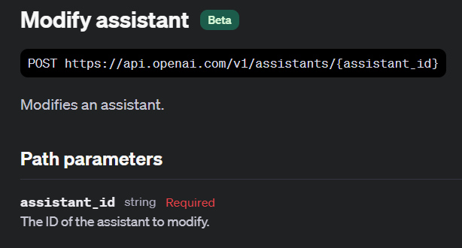

Slide 16
Demo: Updating Assistants
# Create an assistant that uses code interpreter.
modified_assistant = client.beta.assistants.update(
assistant_id="asst_5aEb1Hk1RA3MNU4j5kzshyZ3",
model="gpt-3.5-turbo",
instructions="You are a personal data analyst. When asked a question, write Python code to answer the question.",
name="Python Code Helper",
description="This assistant is designed to help you write Python code to answer questions as a personal data analyst.",
metadata={
"somekey": "somevalue",
"is_awesome": "False", # Lowercase dictionary keys
"is_beta": "True"
},
temperature=0,
top_p=0.6,
response_format="auto",
tools=[],
tool_resources=None,
)

Slide 17
Deleting Assistants
Get Rid of Assistants You Don’t Need!

Slide 18
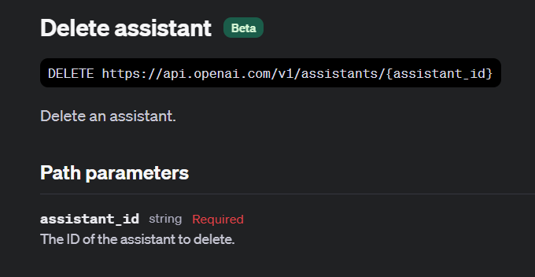

Slide 19
Demo: Deleting Assistants
from openai import OpenAI
client = OpenAI()
response = client.beta.assistants.delete("asst_5aEb1Hk1RA3MNU4j5kzshyZ3")
print(response)

Slide 20
